Slide 1
Final Emblem Dating Adventure XXIII: Beach Filler Episode
By: Seth Wolfgang, Isabella Snyder, and Cody DeLano
Notes:
^{owo uwu awoo}

Slide 2
Overall Idea
Final Emblem is a Strategy RPG with dating elements, to add some extra spice into the mix! We hope to focus of some main points.
Grid based map system
Combat
A Robust relationship system
Notes:
Seth

Slide 3
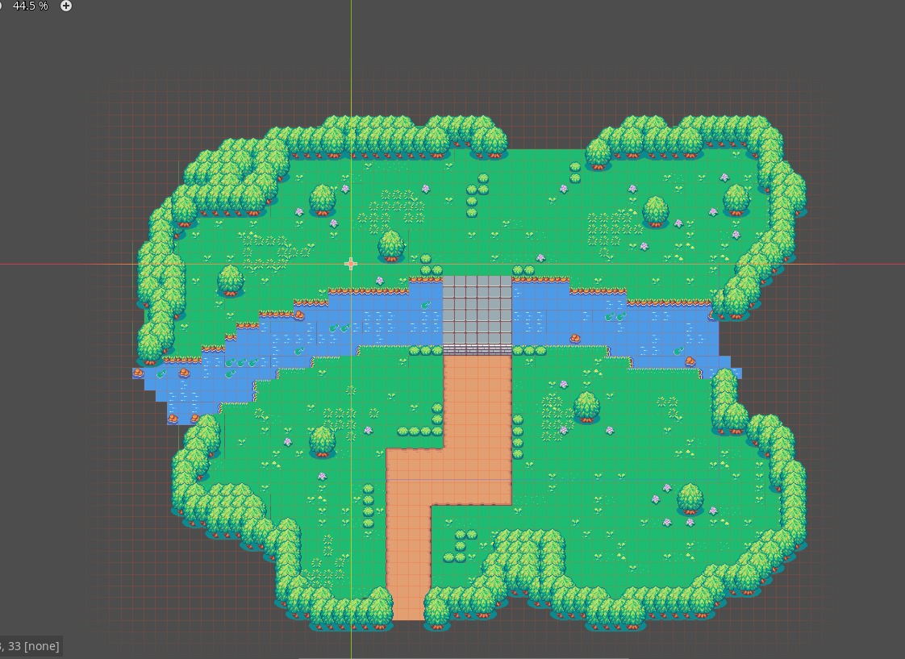
Maps
<MAP SAMPLE GOES HERE>
The central element to strategy games is how we move around a scene. Our vision includes:
A colorful and fun scene
A play area that encourages creativity
Makes strategizing fun and unique
The bridge to the beach
Notes:
Seth

Slide 4
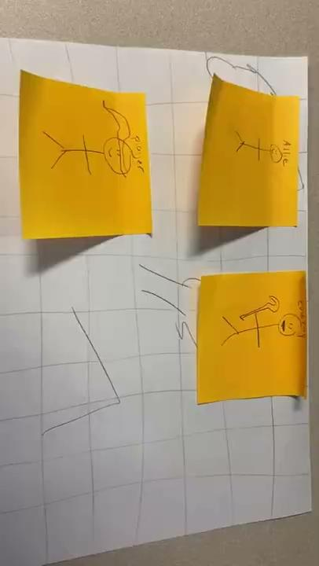
Combat
Functionality!
<Idk what goes here>
Combat is what makes strategy games unique.
Tactical and Strategic
Easy to understand
Low learning curve
Notes:
Izzie

Slide 5
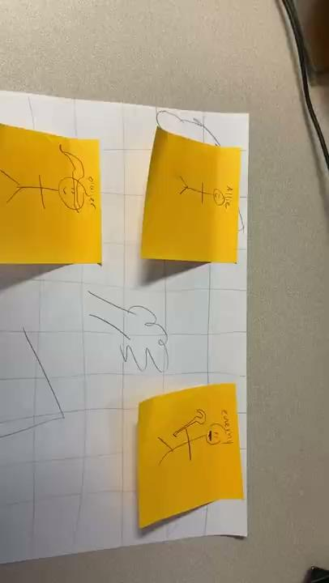
Relationships
Yay! More functionality!
Every TRPG needs its spicy relationships.
As CS majors, we need all we can get…
Affection points
Combat boosts
Cutscenes
Notes:
Izzie!

Slide 6
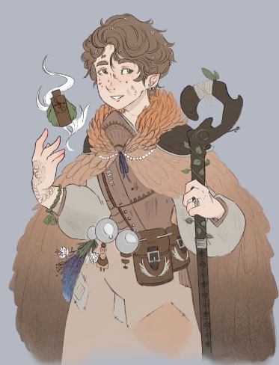
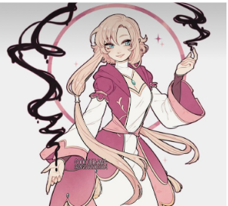
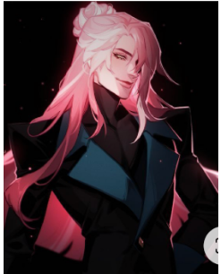
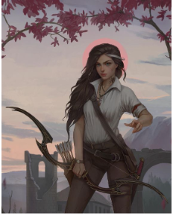
Characters!
The game will have 8 ally units for you to battle alongside and romance! Each is a unique character design each with different classes, such as druid, wizard, bard, ranger and more!
Notes:
Izzie!

Slide 7
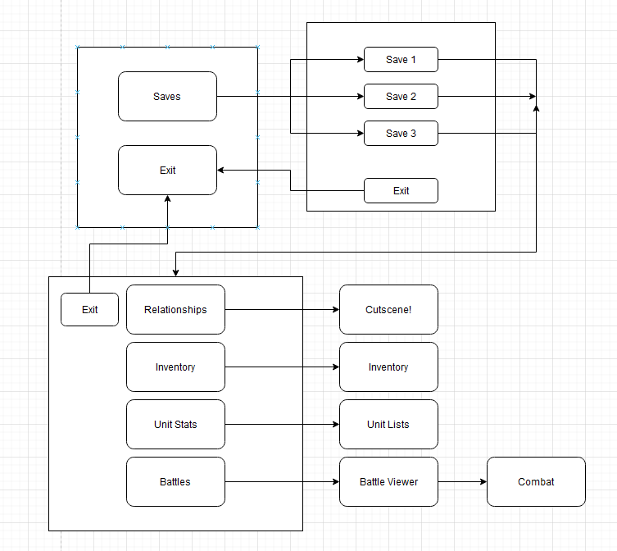
Project Mockup
Top text
Bottom text
Notes:
Cody yes

Slide 8
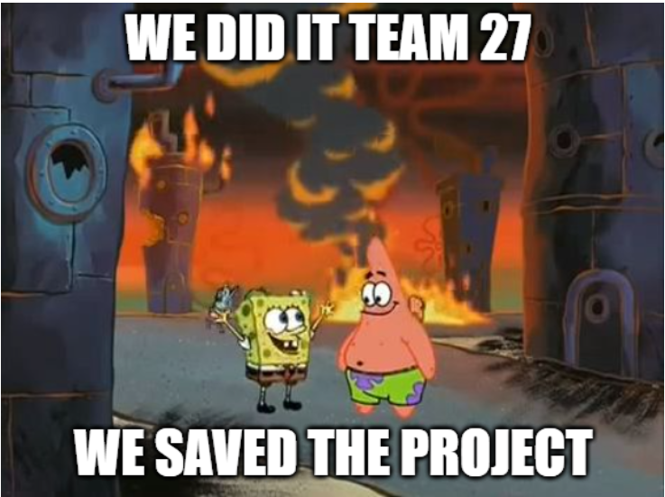
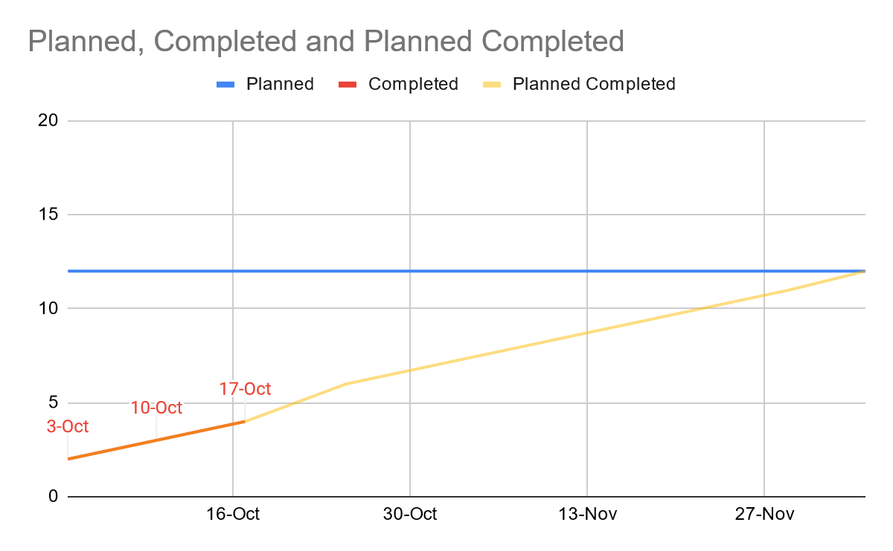
Burndown Chart
BURN UP CHART (DELICIOUS MINT COLOR)
FOR CODY TO DO SAVE MY SOUL
Burn up for what
B
Burn down for what
Notes:
Cody

Slide 9
Finisher
Notes:
_{small} Man Cody

